Slide 1
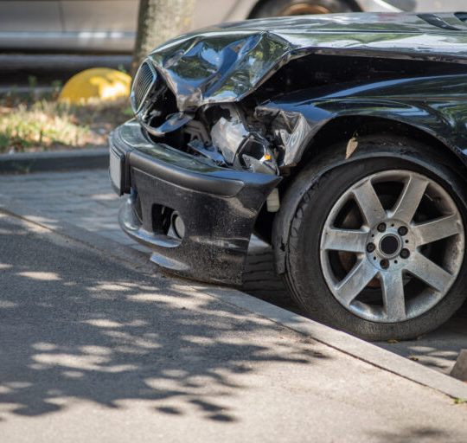
SafeRide AI: Real-Time Accident Detection and Assistance System
AKSAYAA s v – 221701006
Gowri Nanda M -221701016

Slide 2
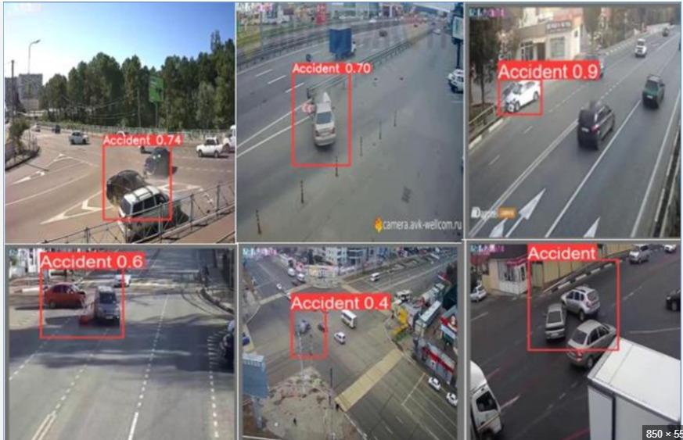
ABSTRACT
Real-Time Crash Detection – Uses AI to detect vehicles, analyze crashes, and monitor helmet compliance.
Instant Alerts – Notifies police, ambulance, and vehicle owners with crucial accident details.
Automated Insurance Claims – Initiates claim processing for faster settlements.
Enhanced Road Safety – Promotes responsible driving and streamlines emergency response

Slide 3
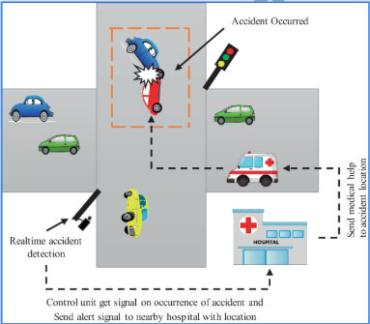
PROBLEM STATEMENT
This project aims to develop an Accident Detection, Alert, and Assistance System using machine learning to detect vehicles, monitor helmet usage, and identify how and when crashes occur. The system will send real-time alerts to the police, ambulance services, and registered vehicle owners while also integrating an insurance claim initiation feature to streamline post-accident processes. By enhancing road safety and enabling timely emergency responses, this solution reduces fatalities and promotes responsible driving behavior.

Slide 4
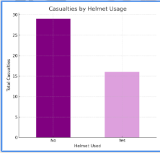
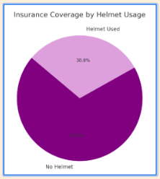
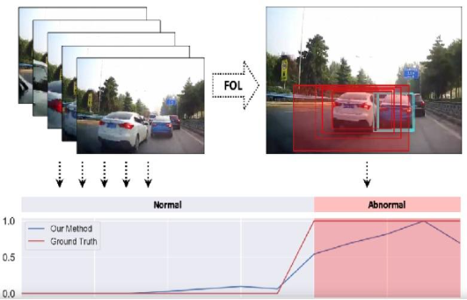
OBJECTIVE
Traditional Reporting: Slow, manual accident reporting delays emergency responses.
Sensor Integration: Accelerometers, GPS, and gyroscopes enable real-time collision detection.
AI & ML: Machine learning (e.g., Random Forests, Neural Networks) enhances detection accuracy.
IoT & V2X: IoT devices and Vehicle-to-Everything technology enable real-time emergency alerts.
Challenges: Address high false alarm rates and cost barriers.
Future Scope: Deep learning and smart city integration offer faster, more accurate systems.

Slide 5
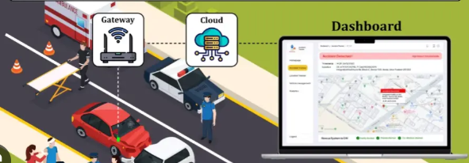
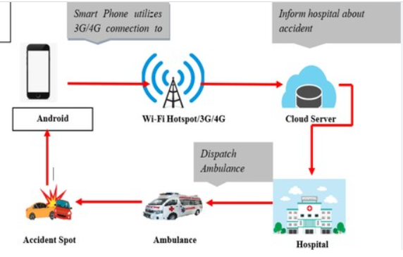
LITERATURE SURVEY
Systematic Literature Survey on Accident Alert & Detection System , IEEE, 2019
Smart copilot for Real time automobile accidents detection
Develop an intelligent Accident Detection & Assistance System that:
Detects vehicles in real time using machine learning.
Monitors helmet compliance to identify high-risk riders.
Identifies crashes through video & sensor data analysis.
Extracts vehicle plates via OCR, linking to owner details.
Sends instant alerts to police, ambulance, and vehicle owners with crash info (location, severity).
Automates insurance claims for faster processing.
Enhancing road safety, enabling quicker emergency responses, and simplifying post-accident procedures to save lives and promote responsible driving.

Slide 6
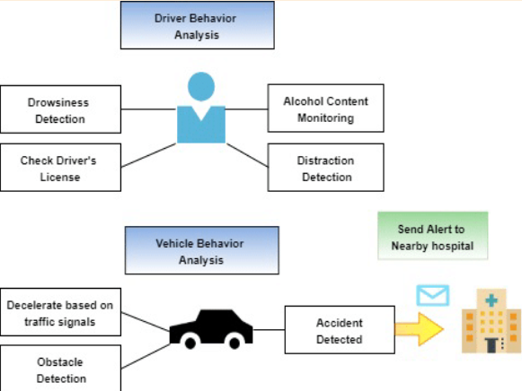
METHODOLOGY OF IDEA
Vehicle Detection: Real-time vehicle detection using YOLOv5.
Helmet Monitoring: Detect helmet compliance with object detection.
Crash Detection: Analyze video & sensor data for crash identification.
License Plate Recognition: Extract plates using OCR.
Alert System: Instant alerts via Twilio/Firebase to police, ambulance, and vehicle owners.
Insurance Claim: Auto-generate reports and initiate claims.
System Integration: Unified platform for seamless operation.

Slide 7
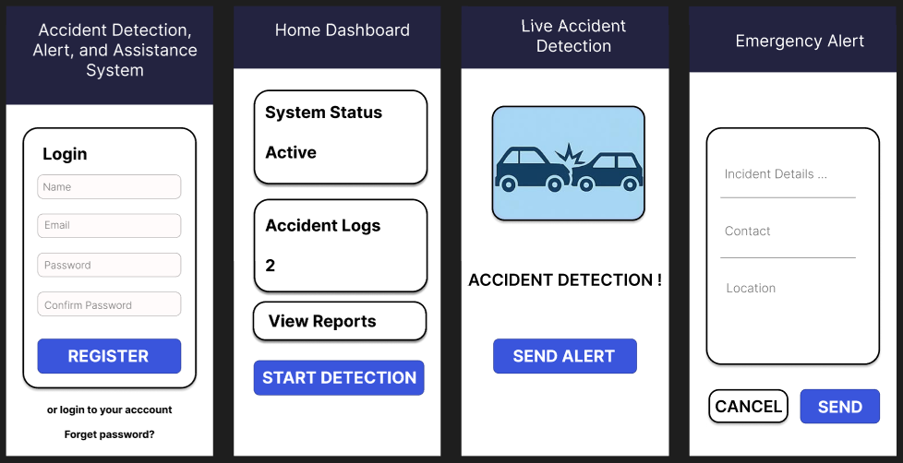
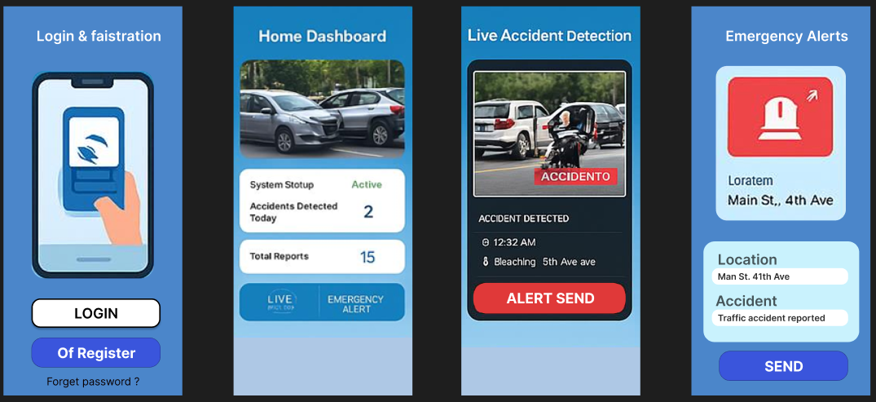
UI of the project …

Slide 8
links
https://drive.google.com/drive/u/3/folders/1cE6gaHrWjGioOXxmDTUztbnsoM5S3WRr
https://github.com/aksayaa745/Accident_Detection_ml

Slide 9
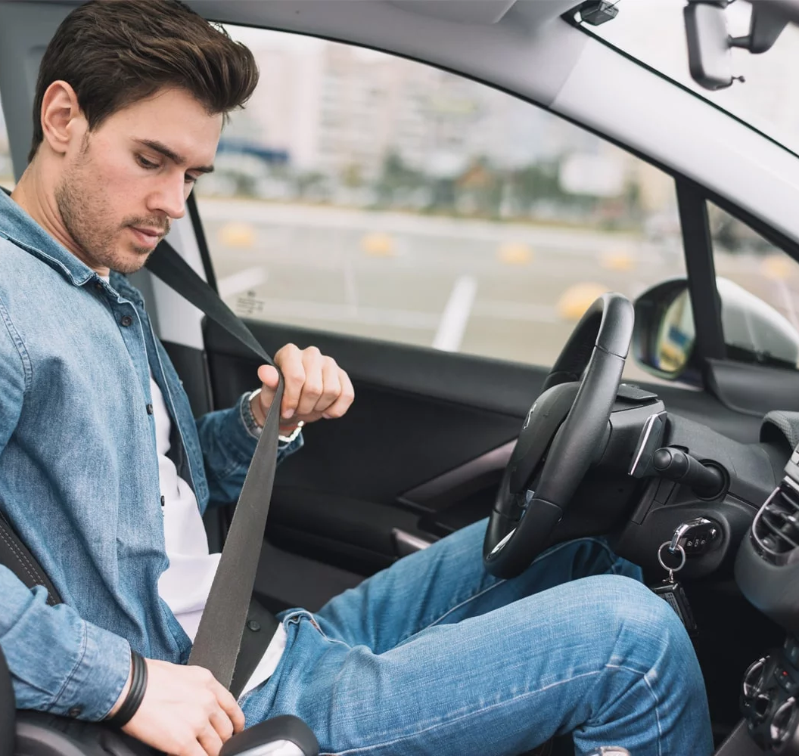
THANK YOU !!!
.

